Slide 1
PROGRAMMING STATUS REPORT · WEEK 3
Pre-Thesis Demo
A 1–6 player online co-op psychological horror game
Unity 6.5 · Mirror · Epic Online Services
REPORTING WEEK
HEAD PROGRAMMER
SUB PROGRAMMER
Week 3 · 8–12 Sep 2026
Mr. Kongkidakorn Chuayjang
Mr. Atiroj Kemwanicha
Status: the game is now playable online between two machines.
Notes:
Week 3 report. Headline: the demo crossed from single-machine prototype to a real online session between two clients.

Slide 2
SCOPE
What the demo has to prove
Online co-op, 1–6 players
1
One host, up to five joiners, matched through Epic Online Services — no IP addresses, no port forwarding.
The 13 Rules of Horror
2
A dynamic rule system that changes what is safe to do during a run. The design thesis of the game.
Persistent progression
3
Equipment and currency survive between runs, stored encrypted on the player's own machine.
Out of scope for the demo by decision: multiple maps. One map ships now; the map pipeline is thesis work.
Pre-Thesis Demo | Programming Status Report
01

Slide 3
PROGRAMMING TEAM
Who writes what
1
Mr. Kongkidakorn Chuayjang
2
Mr. Atiroj Kemwanicha
Head Programmer
Sub Programmer · Gameplay
Networking architecture (Mirror + EOS)
Room creation, matchmaking, room browser
Encrypted save / progression system
Offline ↔ online dual-mode infrastructure
Integration: making feature code network-safe
Player movement and first-person camera
Interaction system (doors, levers, props)
Health and damage model
Downed / revive system
Gameplay-facing UI behaviour
Where the two meet:
gameplay features are written single-player first, then rewritten by the head programmer to run under server authority. A scheduled step, not a repair.
Pre-Thesis Demo | Programming Status Report
02

Slide 4
HEADLINE
This week the game went online
✓
✓
✓
Rooms
Presence
Sandbox
A host creates a room on EOS; another machine finds and joins it.
Two machines share one world — both players spawn on both clients.
Solo test scenes work again with no server, so feature work is unblocked.
Where that leaves the demo
The networking risk — the part that could have failed late and taken the whole demo with it — is retired. What remains is content and feature work on a connection that has been shown to hold.
Pre-Thesis Demo | Programming Status Report
03
Notes:
The next three slides are the evidence for these three milestones, in order.

Slide 5
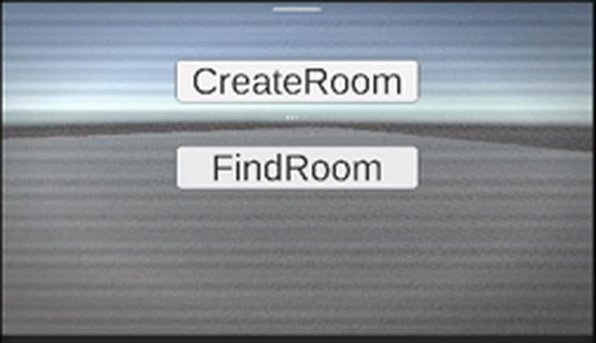
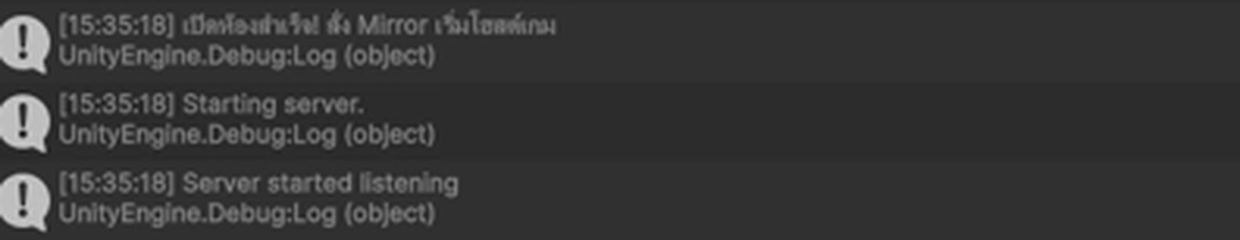
EVIDENCE · PLAYTEST RECORDING
Milestone 1 — rooms on Epic Online Services
Editor console during the run — host side
Room config carried into the lobby:
map = demo_map_01 · difficulty = Normal · players = 6
Room settings are published as EOS lobby attributes, so the browser can show map, difficulty and player count before joining.
Passwords are deliberately NOT lobby attributes — EOS makes those readable by anyone searching.
MainMenu — the two entry points under test
Create Room → opens an EOS lobby, then starts the Mirror host
Find Room → searches EOS and returns every open room
Pre-Thesis Demo | Programming Status Report
04

Slide 6
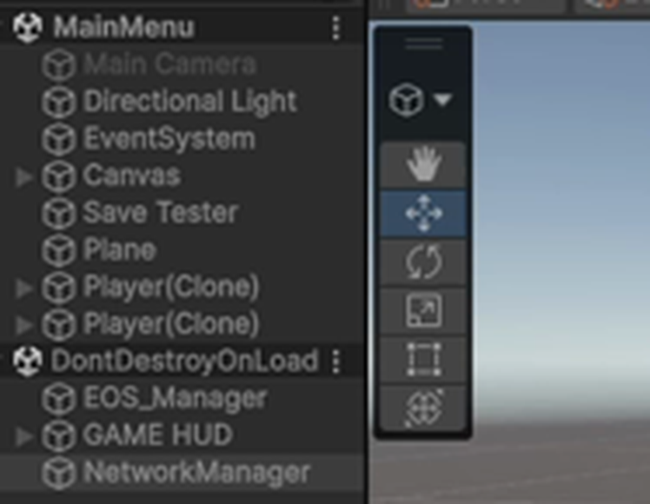
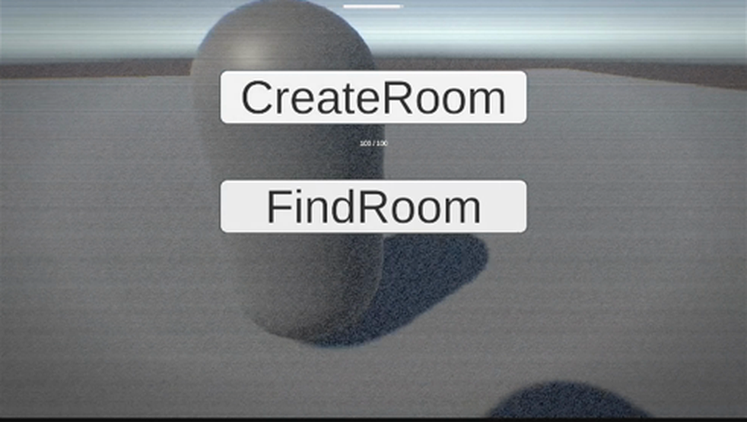
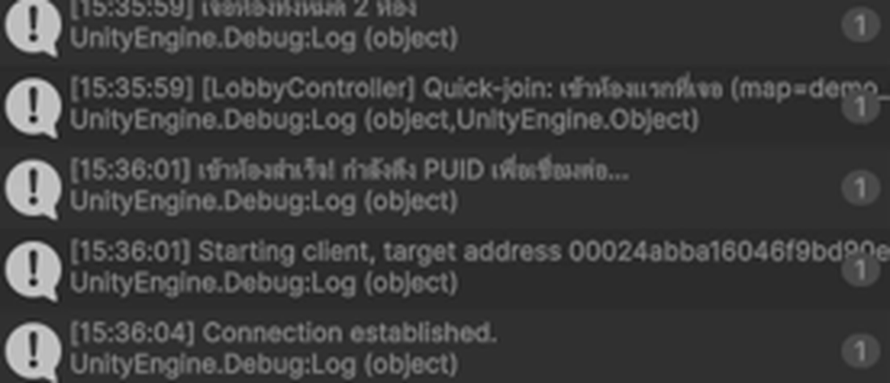
EVIDENCE · PLAYTEST RECORDING
Milestone 2 — two machines, one world
Client connection log
“Connection established” after the client resolved the host's EOS product user ID.
Host scene hierarchy
Two Player(Clone) objects — host and remote client — in the same scene.
Game view — the other player is visible and moving
This is the result that was failing last week: the client connected but no player objects appeared. Root cause was a prefab registration mismatch between the two machines' checkouts.
Pre-Thesis Demo | Programming Status Report
05

Slide 7
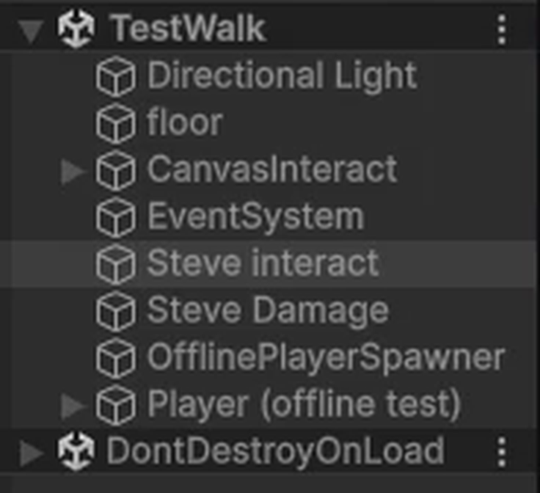
EVIDENCE · PLAYTEST RECORDING
Milestone 3 — solo testing works again
The problem
Mirror force-disables every scene object carrying a NetworkIdentity so the server decides when to spawn it. In a sandbox scene there is no server — so interactable props disappeared the moment Play was pressed.
The fix
A dedicated offline mode. With no server and no client running, a spawner places a player and re-enables the scene objects Mirror switched off. Two earlier attempts failed on timing — Mirror's pass runs after Awake.
TestWalk in Play mode — nothing has vanished
Editor log confirming the offline spawn
In a real match this code does nothing — it is gated on there being no server and no client.
Pre-Thesis Demo | Programming Status Report
06

Slide 8
ENGINEERING
Problems that were not obvious
SYMPTOM
WHAT WAS ACTUALLY WRONG
RESOLUTION
Two EOS SDKs in one build
Two different Epic integrations were installed, colliding on the same native library.
Removed the unused one. Build went to 0 errors.
1
Client saw an empty world
A server can instantiate a prefab it references; a client can only spawn one that is registered.
Identified the checkout mismatch between machines.
2
Props vanished on Play
Mirror disables scene objects after Awake, so an Awake-time fix runs too early to see it.
Rewrote the fix to watch across frames.
3
Lobby creation rejected
Epic login is asynchronous; the button could be pressed before login finished.
Gated room creation on login state.
4
Common thread: each was found by reading the third-party source rather than guessing at its behaviour.
Pre-Thesis Demo | Programming Status Report
07

Slide 9
FORWARD
Next week's plan
Mr. Kongkidakorn Chuayjang
Mr. Atiroj Kemwanicha
HEAD PROGRAMMER
SUB PROGRAMMER
Build the room browser UI on the working search
Move the match out of the menu scene into a real level
Private-room password exchange after join
Start the 13 Rules system: state container and sync model
Extend interaction to the equipment the demo needs
Tune downed / revive timings against playtest feel
Author the props and triggers for the demo map
Priority call for Week 4
The 13 Rules of Horror is the design thesis and is still at zero lines. The networking foundation is finished, so it is time to stop building infrastructure and start building the game the project is actually about.
Pre-Thesis Demo | Programming Status Report
08

Slide 10
SUMMARY · 12 AUG – 12 SEP 2026
Everything built so far
Foundations
Networking
Gameplay
AES-256 encrypted local save system
Auto-load before first scene; one source of truth
Permanent items capped at 1, lost on drop or death
Custom Inspector for live save contents
Editor tooling for network setup checks
Mirror + Epic Online Services integrated and building clean
Create room → EOS lobby → Mirror host
Find rooms → every open room with map, difficulty, player count
Join by Epic product user ID — no IP, no port forwarding
Two-machine session verified: both players spawn and move
Offline ↔ online dual mode for solo testing
First-person movement and camera
Interaction system: doors, levers, props
Health and damage model
Downed / revive with synced timer
All of the above rewritten to server authority
21
C# scripts
2,821
lines of C#
5
Unity scenes
0 / 0
errors / warnings
Pre-Thesis Demo | Programming Status Report
Week 3
Notes:
Close on this slide. One month in: the demo has a working online session, a server-authoritative gameplay layer, an encrypted save system, and a clean build. Remaining work is the 13 Rules system, the demo map, and the room browser UI.

